Slide 1
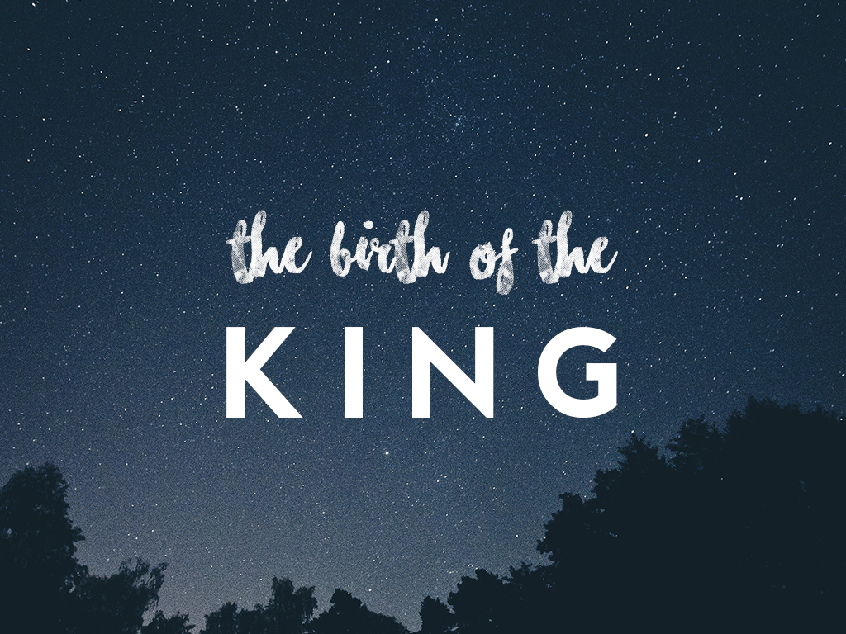

Slide 2
ISAIAH 7
Isaiah 7:14 Therefore the Lord himself will give you a sign: The virgin will conceive and give birth to a son, and will call him Immanuel.

Slide 3
JOHN 1
In the beginning was the Word, and the Word was with God, and the Word was God. 2 He was with God in the beginning.

Slide 4
JOHN 1
3 Through him all things were made; without him nothing was made that has been made. 4 In him was life, and that life was the light of all mankind. 5 The light shines in the darkness, and the darkness has not overcome it.

Slide 5
JOHN 1
14 The Word became flesh and made his dwelling among us.

Slide 6
COLOSSIANS 1
15 The Son is the image of the invisible God, the firstborn over all creation. 16 For in him all things were created: things in heaven and on earth, visible and invisible,

Slide 7
COLOSSIANS 1
whether thrones or powers or rulers or authorities; all things have been created through him and for him. 17 He is before all things, and in him all things hold together.

Slide 8
COLOSSIANS 2
9 For in Christ all the fullness of the Deity lives in bodily form,

Slide 9
LUKE 1
34 “How will this be,” Mary asked the angel, “since I am a virgin?”
35 The angel answered, “The Holy Spirit will come on you, and the power of the Most High will overshadow you. So the holy one to be born will be called the Son of God.

Slide 10
MAX LUCADO
“He was divine enough to enter into the womb of a virgin, but human enough to not get a room for his birth.”

Slide 11
JOHN 1
9 The true light that gives light to everyone was coming into the world. 10 He was in the world, and though the world was made through him, the world did not recognize him. 11 He came to that which was his own, but his own did not receive him.

Slide 12
MAX LUCADO
“He doesn’t come with a list of things you need to do, he comes with a list of everything He has done.”
1. Sin Dealt with, TICK!
2. Death Defeated, TICK!
3. Eternal Future Secured, TICK!

Slide 13
JOHN 1
12 Yet to all who did receive him, to those who believed in his name, he gave the right to become children of God—13 children born not of natural descent, nor of human decision or a husband’s will, but born of God.

Slide 14
A QUESTION?
Do you know who you are turning away?

